Slide 1

Sharepoint Site Select
LV
Lerevit
Controlling app access on a specific SharePoint site collections is now available in Microsoft Graph
Controlling app access on a specific SharePoint site collections is now available in Microsoft Graph - Microsoft 365 Developer Blog

Slide 2
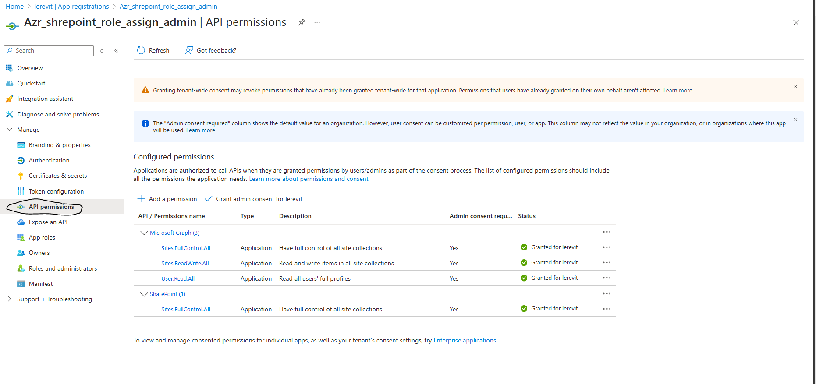
Create a Service Principal With those Permissions below
This Service Principal is Your Admin one , which will assign the Role to all the other one

Slide 3
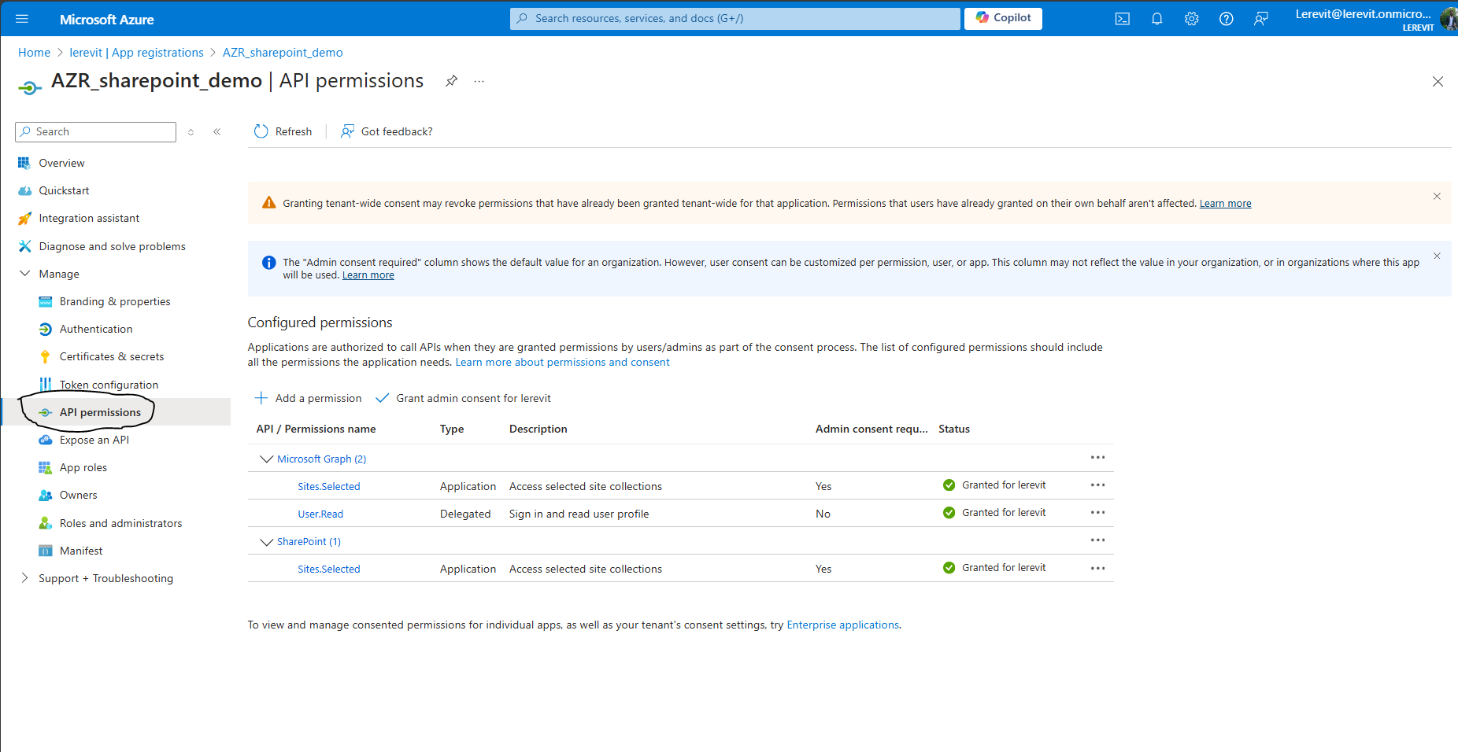
Create a Service Principal With those Permissions below
This Service Principal is Your user one , which role will be assigned to

Slide 4
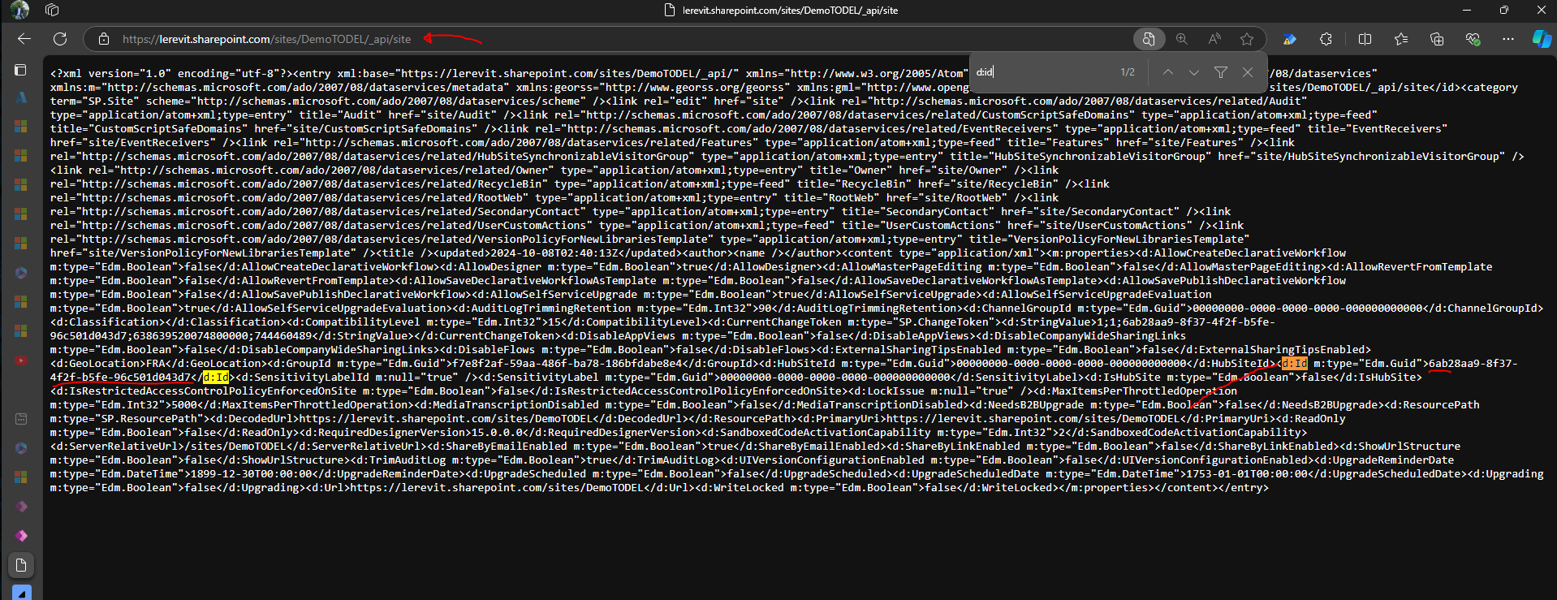
Get ID of a Sharepoint Site
Add /_api/site after your sp site then search for d:id to find the guid id
lerevit.sharepoint.com/sites/DemoTODEL/_api/site

Slide 5
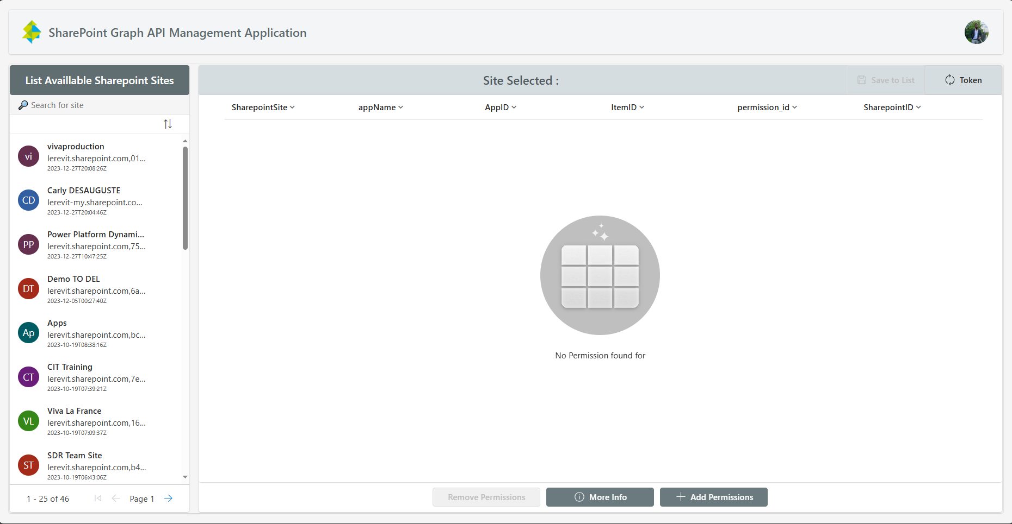
Application Site Selected

Slide 8

Section

Slide 12
Section

Slide 17
Azure Data Factory
LV
Lerevit
Complete Guideline

